Slide 1





SCORE_MORE
Software Project Lab-I
SWE 4304
September 20, 2023

Slide 2

Table Of Content
List of team members
Title of the project.
Project Overview
Motivation behind the project
Key Features
Tools and Technology
Future Scope
Proposed Timeline

Slide 3




Our team
Nabila Islam
Namisa Najah Raisa
Faiza Maliat
210042111
210042112
210042163

Slide 4



Project Title
Score_More
- A sports score generating application

Slide 5

Project Overview
Our project aims to develop a comprehensive Sports Score Generation Application that provides real-time scores, statistics, and updates for a wide range of sports .This application will serve the diverse interests of users by covering various sports.
The primary goal of our Sports Score Generation Application is to provide a user-friendly and feature-rich platform that offers Real-time Scores, Covers Multiple Sports , Customizable User Profiles , Historical Data analysis , User Engagement etc.

Slide 6





Motivation behind the project
Diverse Sports Interests
Historical Data Analysis
Information Accessibility
Global Reach

Slide 7
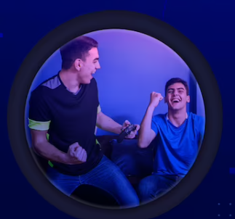


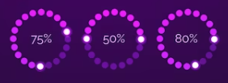
Key Features
Package Development
Score Tracking
Simple Navigation
Prediction
Team and Player Management
Multiple Functionalities
Run Analysis
Run Rate Calculation

Slide 8




Programming Language:
JAVA
Data Storage:
Text File
Tools and Technology
User Interface:
Console-based user interface
Version Control:
GitHub

Slide 9
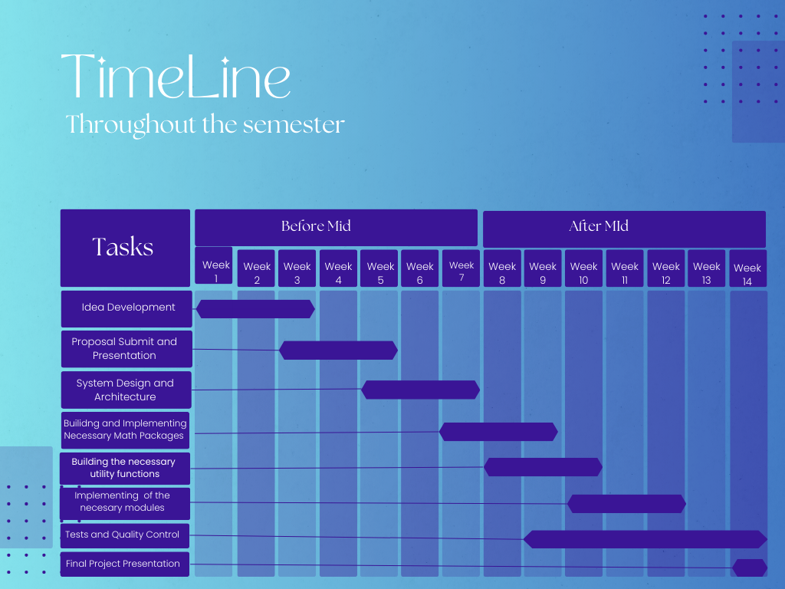
Proposed Timeline:

Slide 10

Future Scope
Run Rate Graph
Match History
Comparison Graph
Sports Diversity
Winning Probability Chart
Wickets Fall Graph
Scoreboard Customization

Slide 11
THANK YOU

